Slide 1



PROJECT PROPOSAL PRESENTATION
PRESENTED TO
You Pay Less, Drivers Earn More...
Namma Yatri Open Mobility Challenge
PRESENTED BY
Sai Nikhitha D
Lalithya G
Chethan Reddy Chinthaparthi

Slide 2
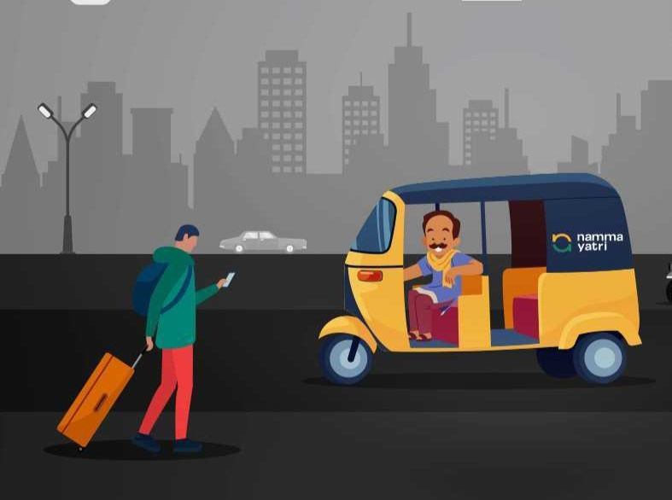
Introduction
Namma Yatri is a Direct-to-Driver app.
The ability to book a Namma Yatri auto could open up more demand.
Namma Yatri, an auto-rickshaw ride-hailing service, wants to increase its customer base.

Slide 3



Problem
Statement
Namma Yatri, an auto-rickshaw ride-hailing service, wants to increase its customer base by providing innovative tech solutions for booking autos without requiring customers to install the app.
Currently, customers can only book an auto through the Namma Yatri app, which may not be convenient for some users who are uncomfortable or unwilling to use apps.

Slide 4



Solutions Proposed
Solution # 1
Website: We will build a website that allows customers to book a Namma Yatri auto online.
Solution # 2
WhatsApp: We will integrate Namma Yatri's booking system with WhatsApp, allowing customers to book a ride through the messaging app.
Solution # 3
SMS: We will provide an SMS-based booking system that allows customers to book a ride through text messaging.

Slide 5

Statistics
Item 2
35%
Item 1
65%
Staticstics showing 35% of People dont prefer App based Booking.

Slide 6

Our Solution
Web-based Platform
Our solution involves a web-based platform that enables users to book Namma Yatri autos without the need for a mobile app.
The platform will be built using a combination of front-end and back-end technologies and will consist of several different components.

Slide 7
Components
1
3
5
Registration/Login Page
Booking Page
Auto Details Pop-Up
2
4
6
Virtual assistant tool
Map Interface
Booking Confirmation

Slide 8

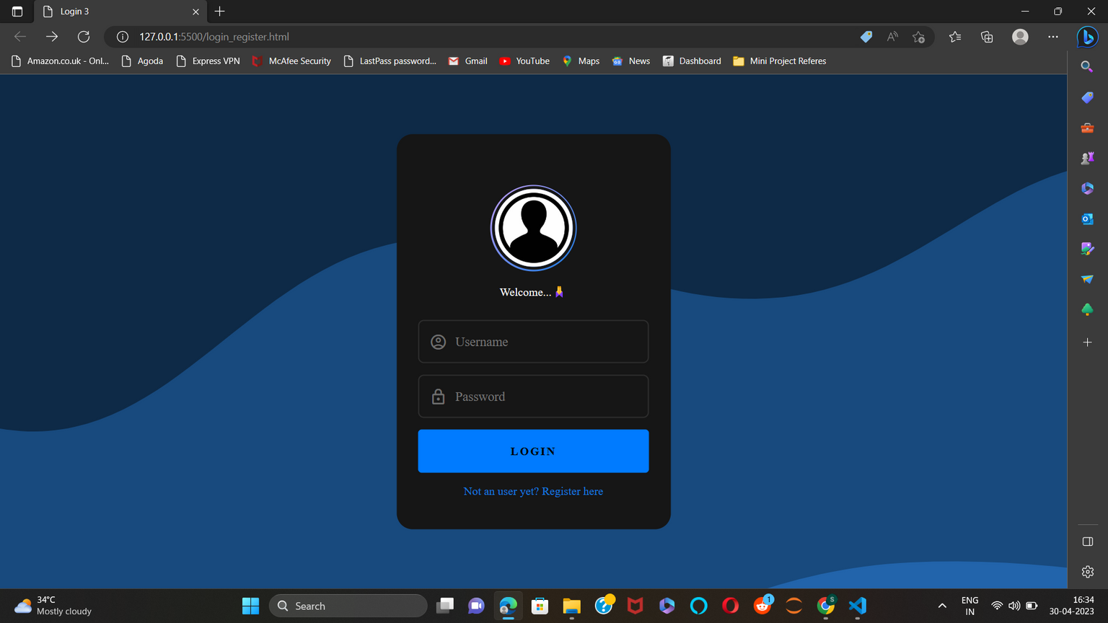

Namma Yatri
Implementation
The user enters the login page once he enters the website.
If he/she has already registered he can directly login to check for booking a ride.
If not the user has to first register to enter the ride booking page.
Back to Agenda

Slide 9
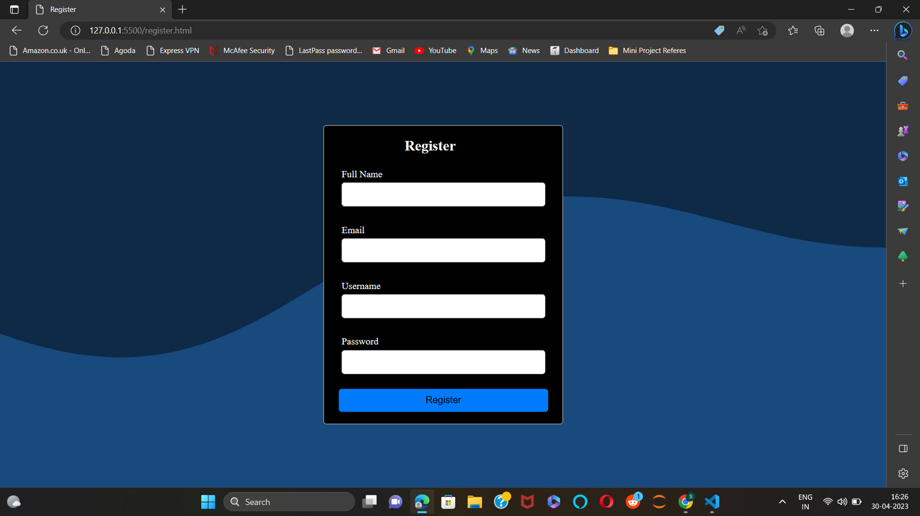
Namma Yatri
Implementation
If the user has not yet registered he has to register by filling up the required details.
After registering the user will be redirected to the login page to login in order to verify his credentials.
Back to Agenda

Slide 10
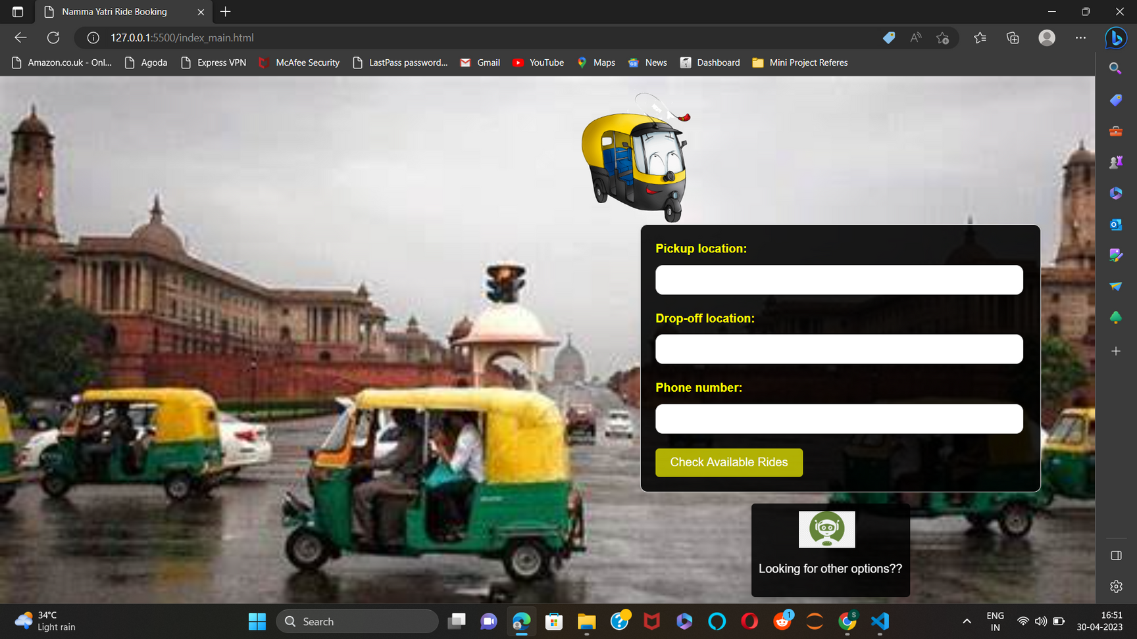
Namma Yatri
Implementation
After the user has logged in successfully, he/she will be directed to a page where they will have to select the pickup and dropping locations.
The user fills another form here choosing their pickup and dropping points along with the user's phone number.
They can check the autos nearby their surroundings by clicking on the check available rides button.
Back to Agenda

Slide 11
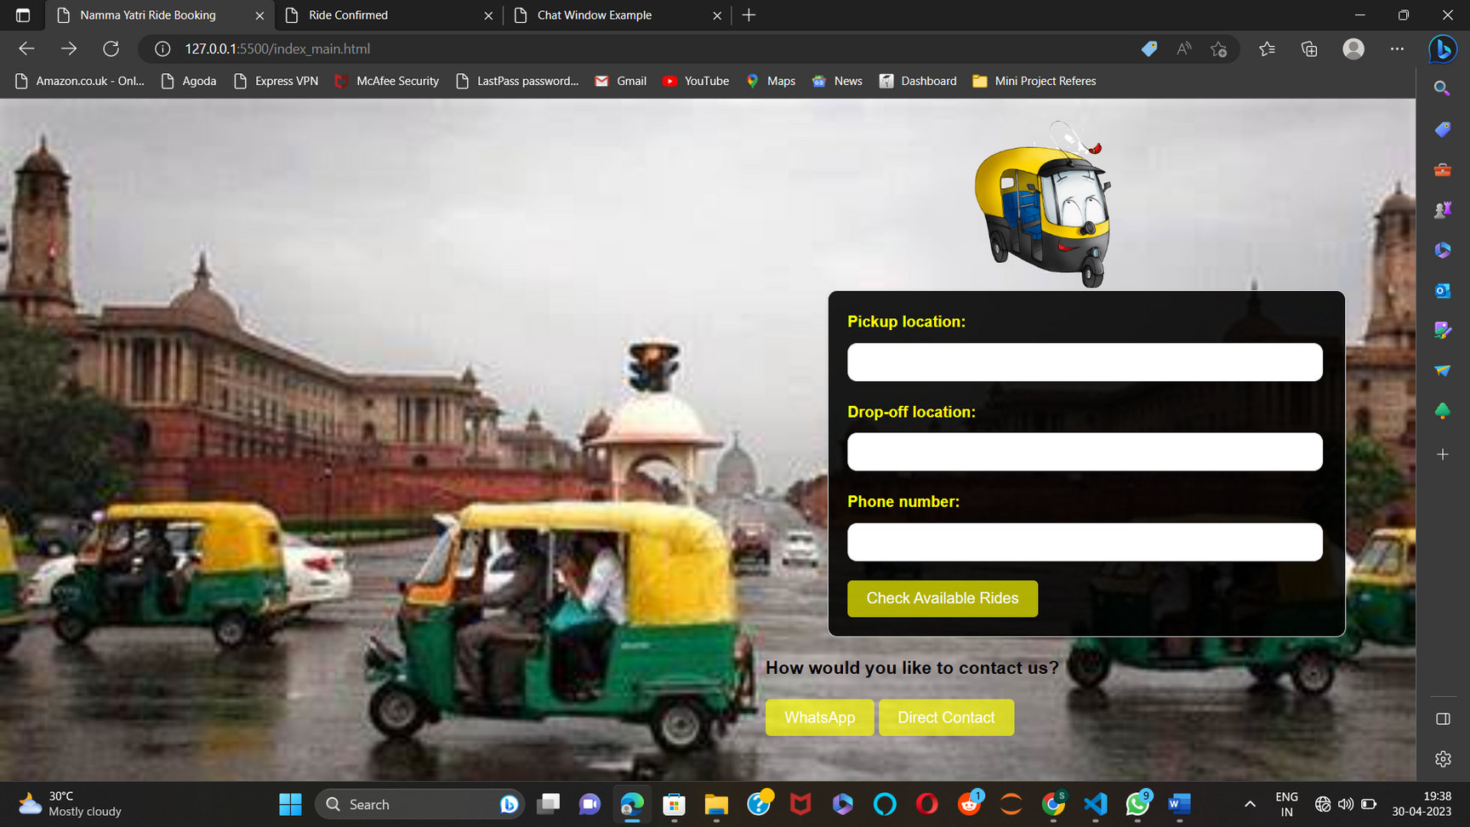
Namma Yatri
Implementation
We can have a virtual assistant like Siri that can help or guide the new users to book their ride at ease.
We can include other options like enabling the customer to contact helpdesk through whatsapp or call if they are facing any difficulty while booking the ride.
When the user clicks on the helpdesk agent logo the options will be displayed and he/she can make use of them.
Back to Agenda

Slide 12
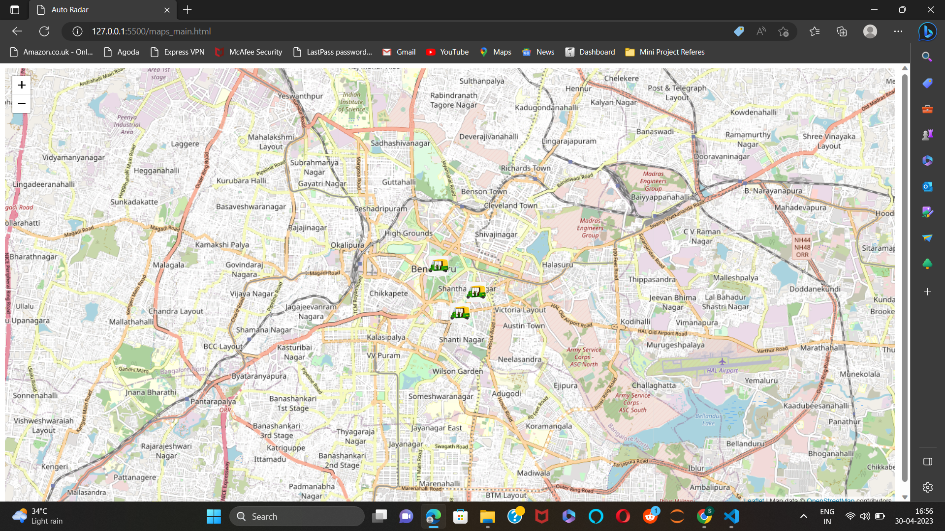
Namma Yatri
Implementation
After the user has filled in the details about his picking and dropping locations a new page opens up showing the autos nearby his/her picking locations.
The user can tap on the auto to know about the driver details.
Back to Agenda

Slide 13
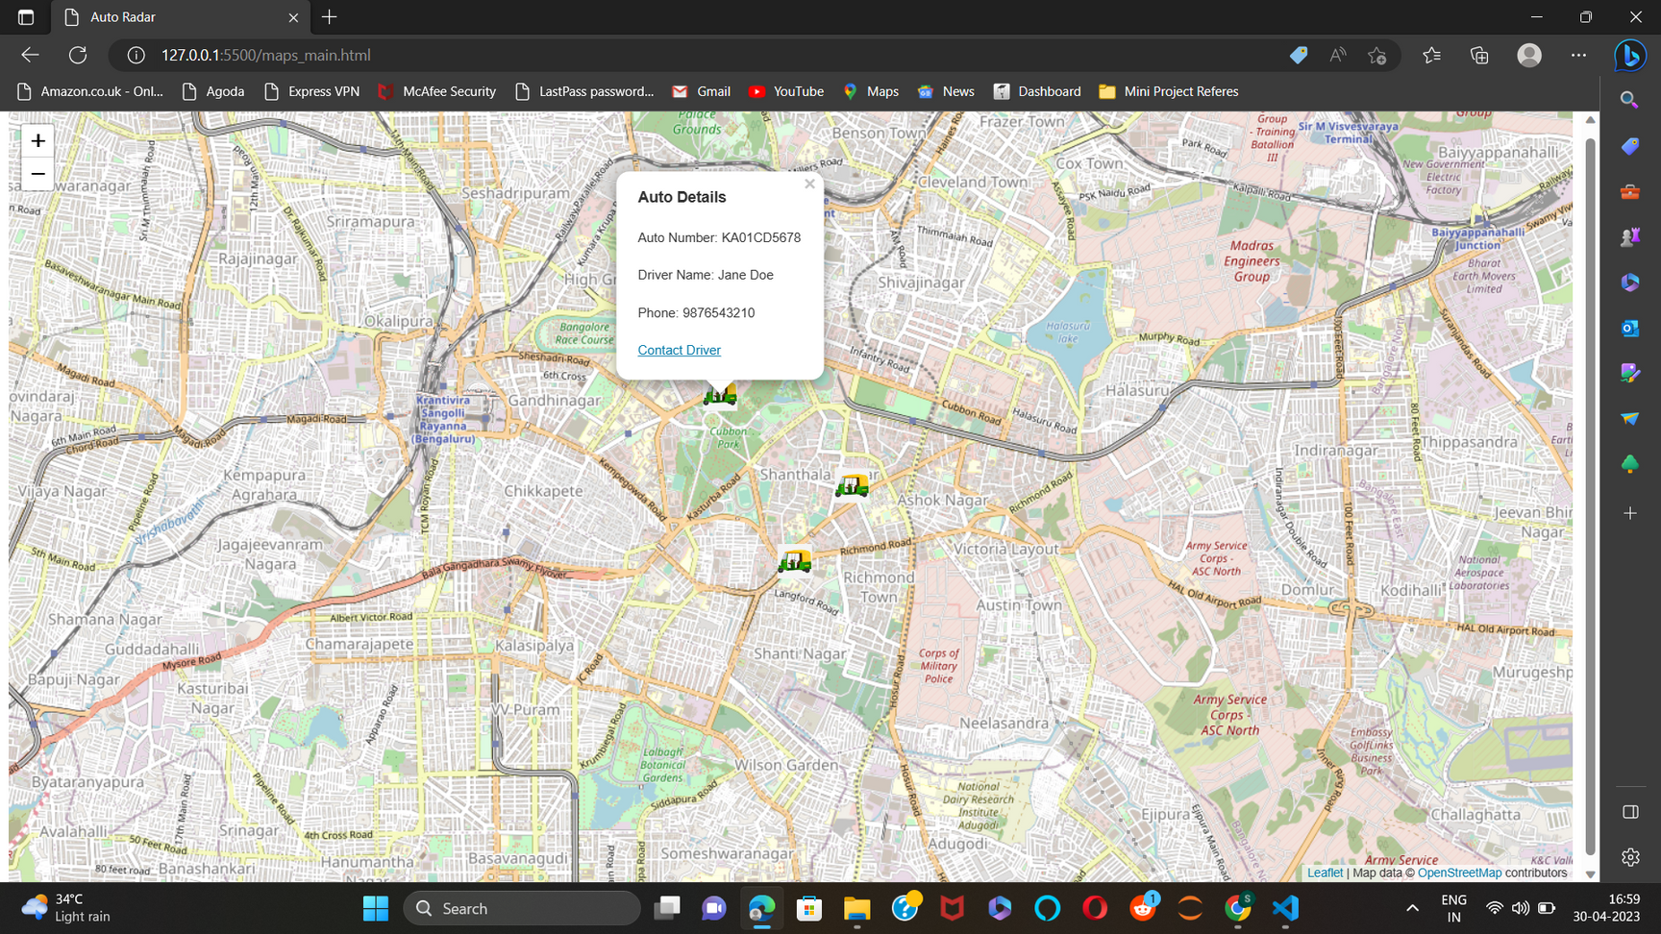
Namma Yatri
Implementation
So,the user can now see the details of the driver by tapping on the auto and he can chat or contact the driver to know more about the charge by clicking on contact driver.
Once he clicks on contact driver another page opens up enabling chatting between driver and user.
If the user is in a rush and if he/she is ready to pay whatever the driver asks they can directly book the ride by contacting the driver through phone.
Back to Agenda

Slide 14
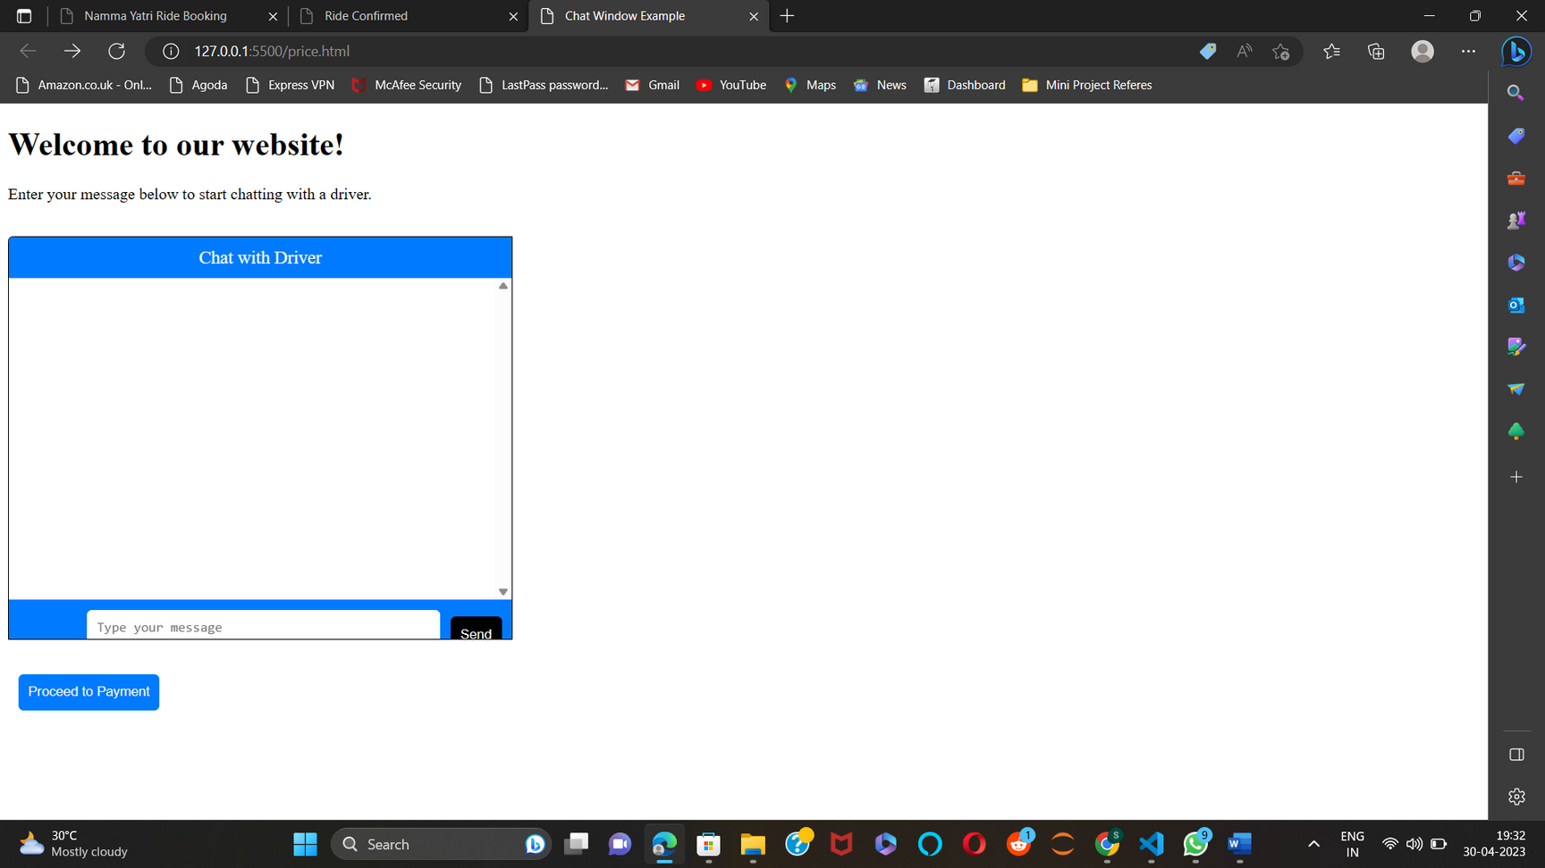
Namma Yatri
Implementation
Here the user can chat with the driver to ask about the price.
The chatting can be enabled in different languages like Kannada,English and Hindi.
So the users find it easy to use the website.
The user can then book the ride at their convenience.
Back to Agenda

Slide 15
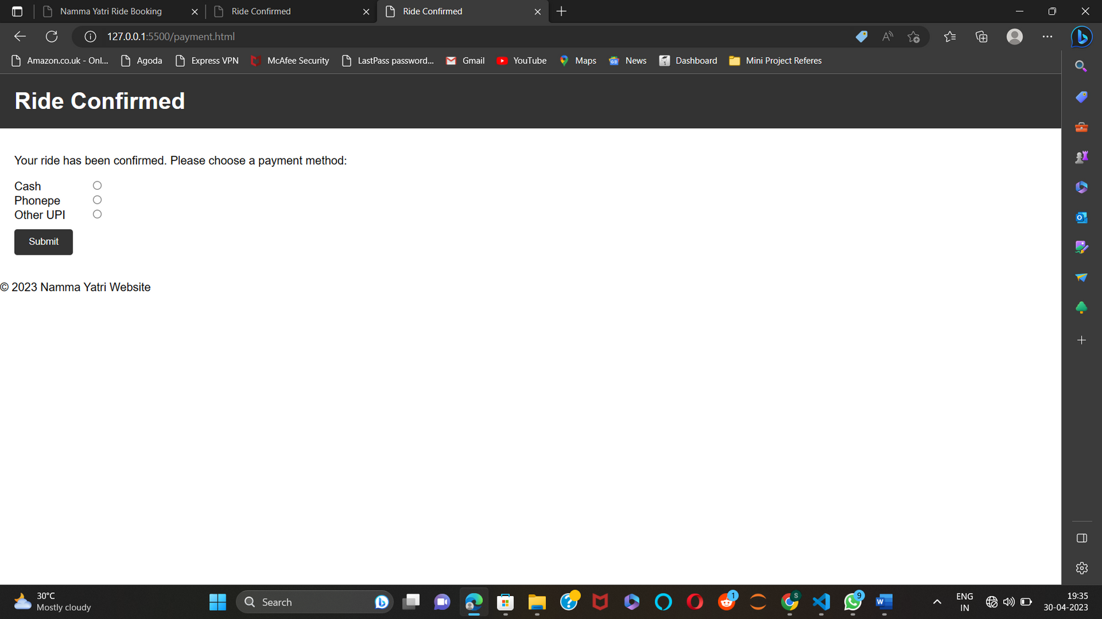
Namma Yatri
Implementation
After the user confirms his/her ride with the driver they will be directed to the payment page.
The payment page will have various options.
Back to Agenda

Slide 16






Accessibility: Our solution provides alternative booking methods that cater to users who are uncomfortable or unwilling to use apps, making transportation more accessible for everyone.
Convenience: Our solution offers multiple booking options that are easy to use and require minimal effort from customers.
Expansion of Customer Base: By offering multiple booking options, Namma Yatri can expand its customer base and tap into a broader market, leading to increased demand and revenue.
Competitive Edge: Our solution differentiates Namma Yatri from its competitors by providing more booking options and enhancing the overall customer experience.
Benefits of our solution

Slide 17
Conclusion
The website built is a prototype and it has potential to be a successful ride booking website. Although, there are many changes that need to be done before it can be launched as a final product. The website has some basic functionalities such as displaying available rides, providing ride details, allowing users to book a ride and display payment options. However, the website needs more features such as user authentication, real-time updates on ride status, booking confirmation and cancellation options, and more. Moreover, the website needs to be optimized for performance and user experience. Despite the limitations, the idea of this website is surely going to be a great success as it addresses the needs of people looking for an easy and convenient way to book auto rickshaw rides. With further development and refinement, this website has the potential to attract a large user base and become a popular platform for booking auto rickshaw rides.
EMAIL
124156094@sastra.ac.in
124156095@sastra.ac.in
124156096@sastra.ac.in

